Slide 1
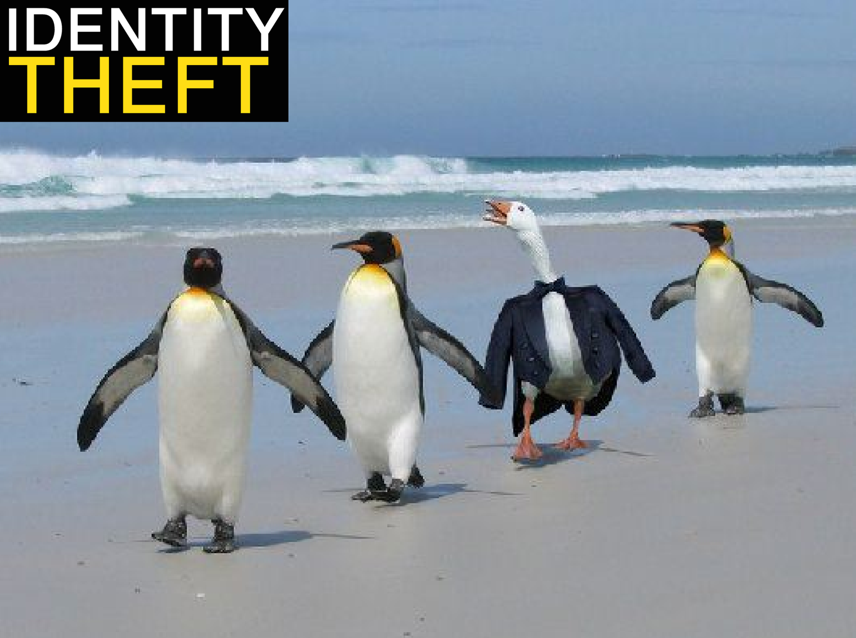
Names: Bryan, Konrad, Mohamed

Slide 2
Definition
Identity theft describes various crimes in which a criminal (or large, well-organized criminal group) uses the identity of an unknowing innocent person” (Haase, 257).

Slide 3
Statistics
CAFC- the Canadian Anti-Fraud Centre maintains statistics on the complaints they receive.
Recent statistical information shows that Canada’s largest credit bureaus Equifax and Trans Union receive over 1800 identity theft complaints from Canadian citizens every month. (Identity Theft FAQ for Canadians)

Slide 4
Statistics Continued
According to studies done in July 2013 (Gartner Research and Harris Interactive) approximately 7 million people become victims of identity theft in North America in the prior 12 months. That is 19,178 per day, 799 per hour and 13.3 per minute. (Identity Theft Statistics)

Slide 5
Bill S-4
“As on January 8, 2010 Senate Bill S-4 became law, making it illegal to possess another person’s identity information for criminal purposes” (Scams and Fraud - Royal Canadian Mounted Police).

Slide 6

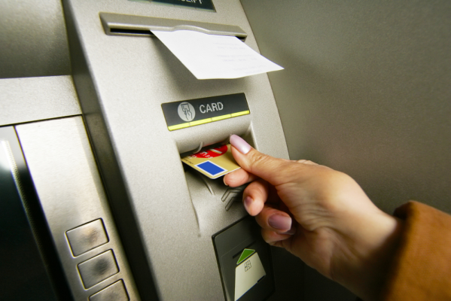
Techniques
Identity theft techniques can range from:
-unsophisticated (such as dumpster diving)
-to more elaborate schemes such as skimming (an electronic method of capturing a victim's personal information)

Slide 7
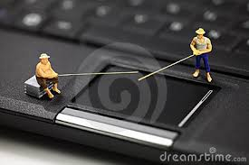

Techniques Continued
phishing - a method carried through the creation of a website that seems to represent a legitimate company)
hacking - conducted with the intent to commit a computer-based, electronic criminal act)

Slide 8
What Identity Thieves Can Do To You?
they will empty your bank account
run your charge cards up to the limit
may take out loans in your name
Victims of identity theft can experience financial laws and difficulty obtaining credit or restoring their “good name”.

Slide 9
What Thieves Are Looking For?
for example:
full name
date of birth
SIN
mother’s maiden name
PIN
bank account number
signature
passport number
driver’s license number

Slide 10

What Your Information Could Be Used For?
access to your bank account
open new bank account
maybe you never opened that account or ordered an additional card, but someone else did
maybe you are just a kid and someone used your name and personal information to commit fraud
apply for loans
receive government benefits
hid their criminal activities

Slide 11
What To Do If It Happens To You?
report it!
contact your local police
call your financial institutions
contact Canada’s main credit agencies (Trans Union Canada and Equifax Canada)
replace your ID card
report the incident to the Canadian Anti-Fraud Centre (CAFC)
for advice on privacy issues, contact the Privacy Commissioner of Canada

Slide 12
Example Of Identity Theft
Man faces 57 charges in 8- year identity theft case.
- Brian Perrault knew something was wrong when he began receiving traffic ticket notices in the mail from jurisdictions he had never visited.
- Then the collection agencies began calling.
- His driver’s license was suspended leaving him unable to work.
After 8 years of nightmare of cleaning his name in January 2012, the police arrested Robert Maitland of Midland, Ontario.

Slide 13
How To Protect Yourself From Identity Theft
“Take advantage of technologies that enhance your security and privacy when you use the Internet.” (15 tips for staying safe online and preventing identity theft)
Monitor your hard copy or online financial accounts frequently and do check your credit report regularly for any unusual activities.
Ask yourself if you really need all of the identity documents you carry in your wallet.

Slide 14
Useful Tips
Install and update antivirus
Disable Bluetooth connection on devices when not in use
Configure your computer (e.g. use unique passwords)
Ignore unsolicited requests for personal information by email or by over the phone
When accessing financial information on your smartphone, only use apps authorized by your bank
Shred all documents that contain personal information
Do not post personal information on social networking sites (e.g. Facebook)
Never lend your credit card
Do not disclose your full 9 digit SIN number, unless absolutely necessary

Slide 15
Useful Tips Continued
Shred all documents that contain personal information
Do not post personal information on social networking sites (e.g. Facebook)
Never lend your credit card
Do not disclose your full 9 digit SIN number, unless absolutely necessary

Slide 16
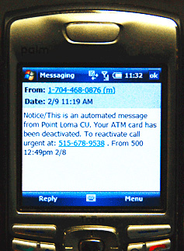
Be Aware Of
Smishing - sending consumers text messages containing a link to a fraudulent website or a phone number in an attempt to collect personal information

Slide 17
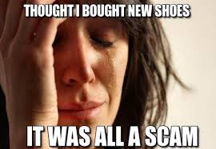
Be Aware Of Continued
Pharming - malicious code that is installed on a personal computer or server, misdirecting users to fraudulent Web sites without their knowledge or consent

Slide 18
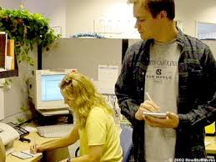
Be Aware Of Continued
Shoulder surfing - direct observation techniques, such as looking over someone's shoulder, to get information

Slide 19
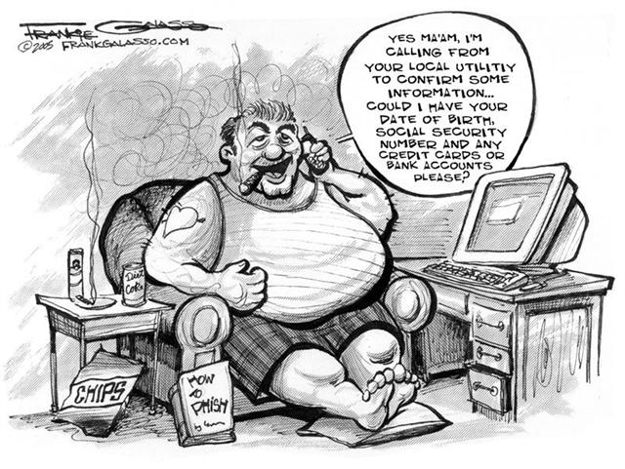
Remember
“There is a reason to be paranoid, there is just a reason to be careful.”(Canadian Fraud Centre)

Slide 20
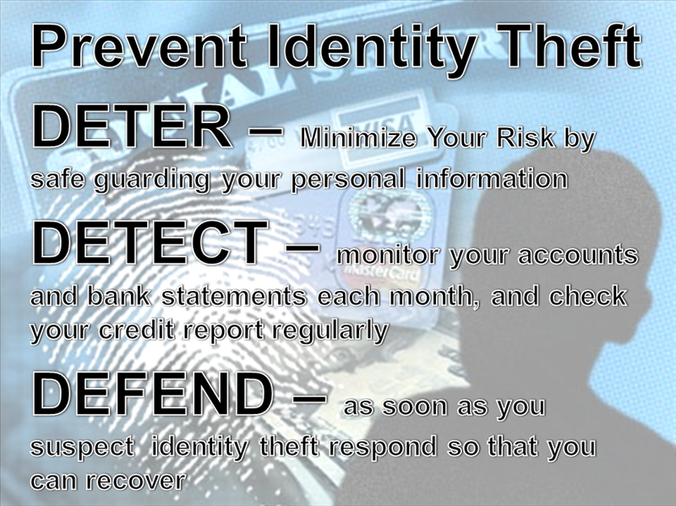
Minimize Your Risk!
By managing your personal information wisely, consciously and with an awareness of the issue, you can protect yourself against identity theft.

Slide 21
References
Haase, Sara. A Gift of Fire: Social, Legal, and Ethical Issues for Computing Technology. Prentice Hall, 2013. Print.
Identity Theft FAQ for Canadians. Web. March 12th, 2014. www.identitytheftfaq.ca
Identity Theft Statistics. id Alerts Canada Inc. Web. March 12th, 2014.
www.idalerts.ca/identitytheftstatistics
Scams and Fraud - Royal Canadian Mounted Police. Web. March 12th, 2014.
www. rcmp-grc.gc.ca/scams-fraudes/index-eng.htm
Canadian Fraud Centre. Web. March 12th, 2014. www.antifraudcentre.ca
15 tips for staying safe online and preventing identity theft. Web. March 12th, 2014.
www.zdnet.com/15-tips-for-staying-safe-online-and-preventing-identity-theft
Man faces 57 charges in 8- year identity theft case . Web. March 12th, 2014.
www.sunnewsnetwork.ca

